Slide 1
4주차 논문리뷰 Practical Deep Reinforcement Learning Approach for Stock Trading

Slide 2
Introduction
Why this paper?
Deep RL + Trading system
DDPG algorithm (actor net, critic net, target net, memory buffer)
compare with DJIA and Min-Variance
Published in 2018, 53 citation
2018 NIPS workshop
Challenges and Opportunities for AI in Financial Services: the Impact of Fairness, Explainability, Accuracy, and Privacy
Why?
Code open
Easy to understand
My goal : DL/DRL + trading / stock prediction

Slide 3


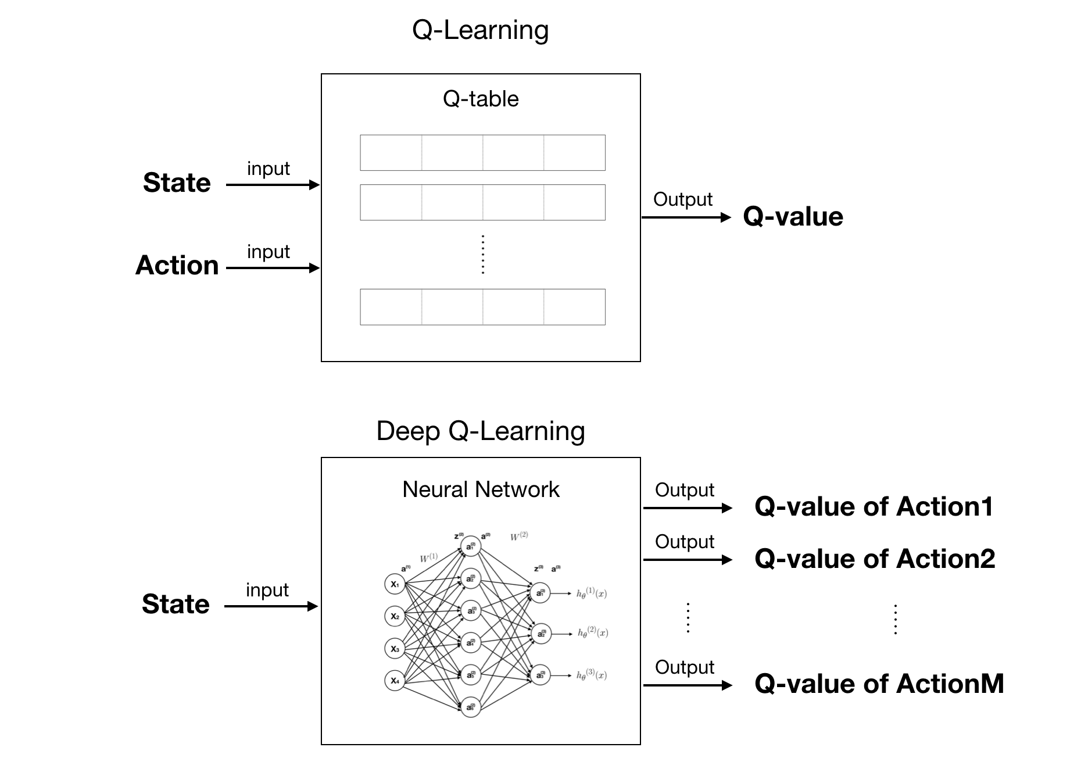
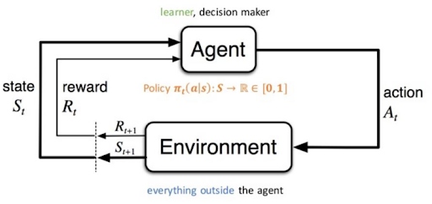
Problem definition
Goal
Making trading agent for maximizing portfolio value using DDPG algorithm
Some concepts
Bellman equation
Reinforcement Learning
Q-Learning
DQN (Deep Q-Network)

Slide 4
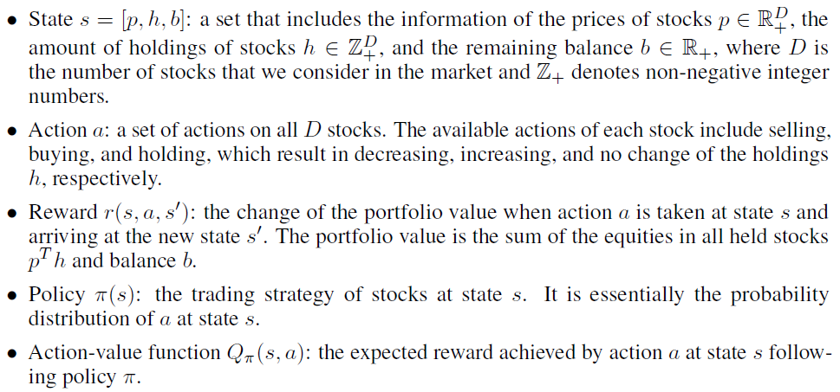
Problem definition
Notation for MDP

Slide 5
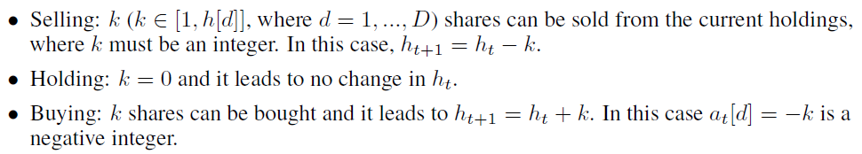

Problem definition
Notation for MDP
Actions
Assumption
all bought stocks should not result in a negative balance on the portfolio value

Slide 6
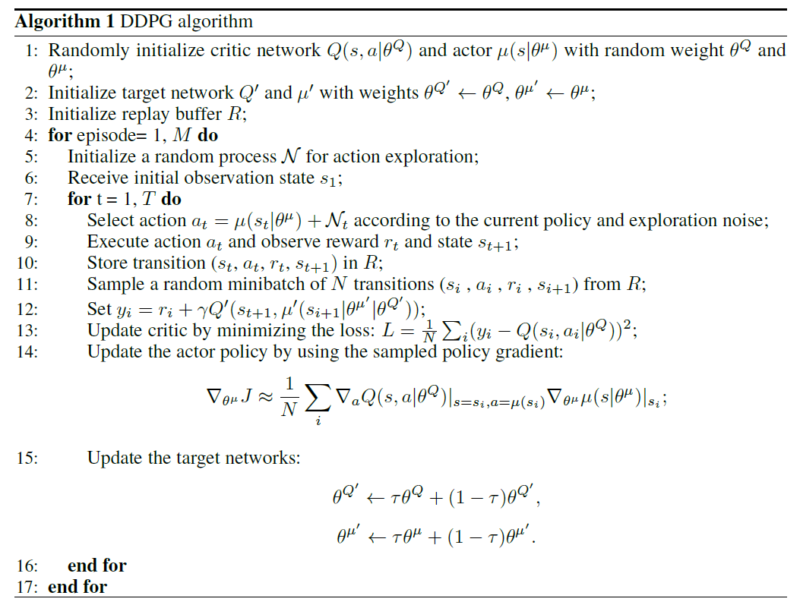
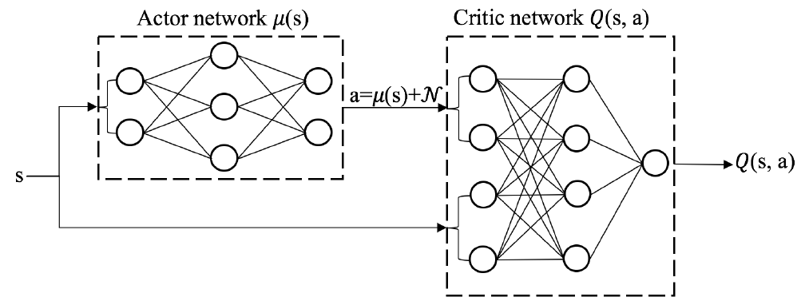
DDPG
Deep Deterministic Policy Gradient
Difference with DQN
Continuous action space
Characteristic
Offline learning (using memory buffer)
DQN + Actor-Critic method
Target network (for stability)

Slide 7
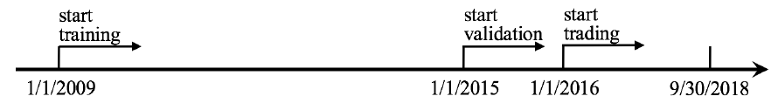
Experiment
Performance Evaluations
Dataset
Dow Jones 30 stocks
Use historical daily prices
Continue training agent while in trading stage
No information for data processing

Slide 8
Experiment
Performance Evaluations
Comparison
Dow Jones Industrial Average (DJIA)
Min-variance portfolio allocation strategy
Metrics
Final portfolio value
Annualized return
Annualized standard error
shows the robustness of agent model
Sharpe ratio
combines the return and risk together

Slide 9
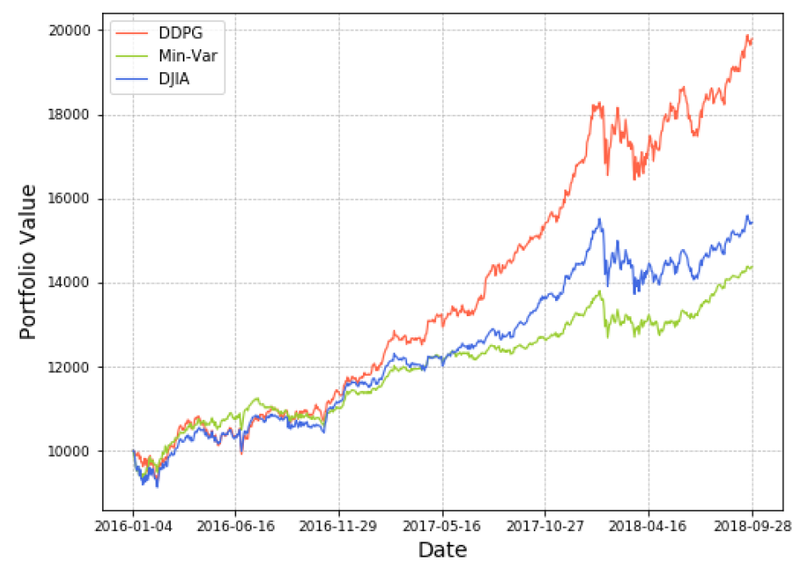
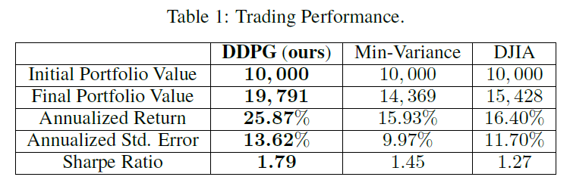
Experiment
Results

Slide 10
END

